Slide 1
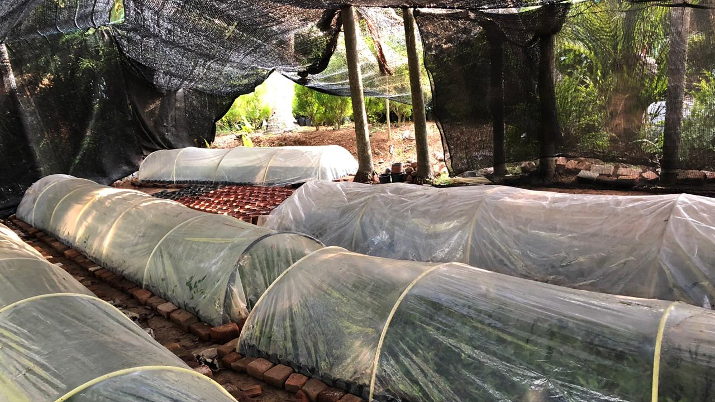
CEM
Controlled Environment Monitors

Slide 2
Current Situation
Propagators are plant nurseries
Objective is to maintain a certain temperature and humidity
Current solution is enclosed environments
Current solutions uses thermometers to measure temperature. Requires manual monitoring.
Temperature goes high in certain areas at times
Very low cost solution

Slide 3
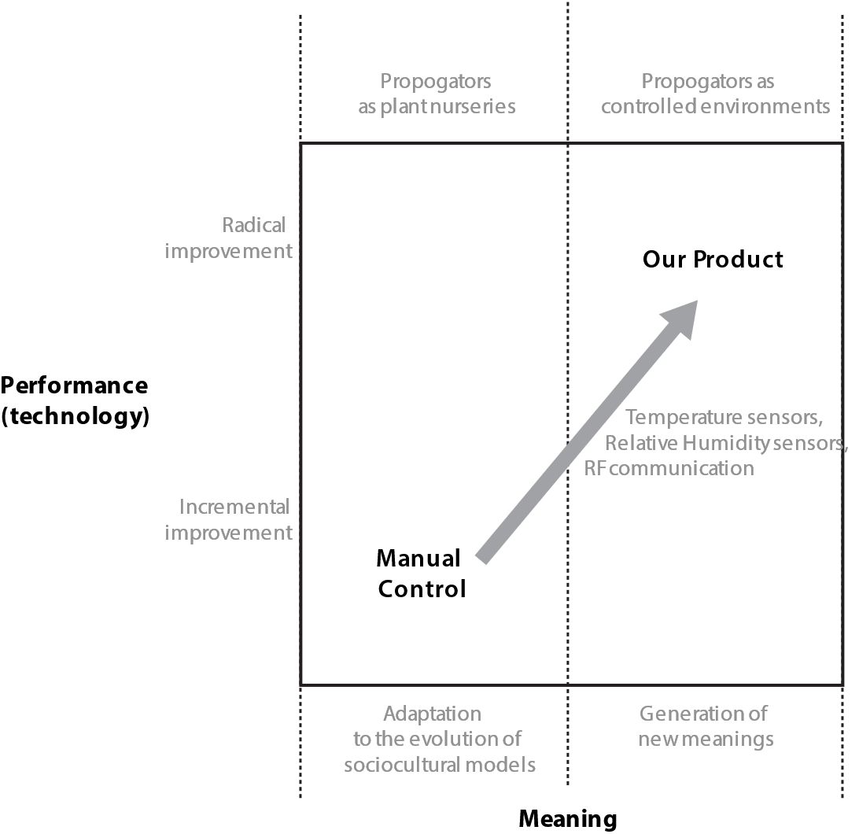
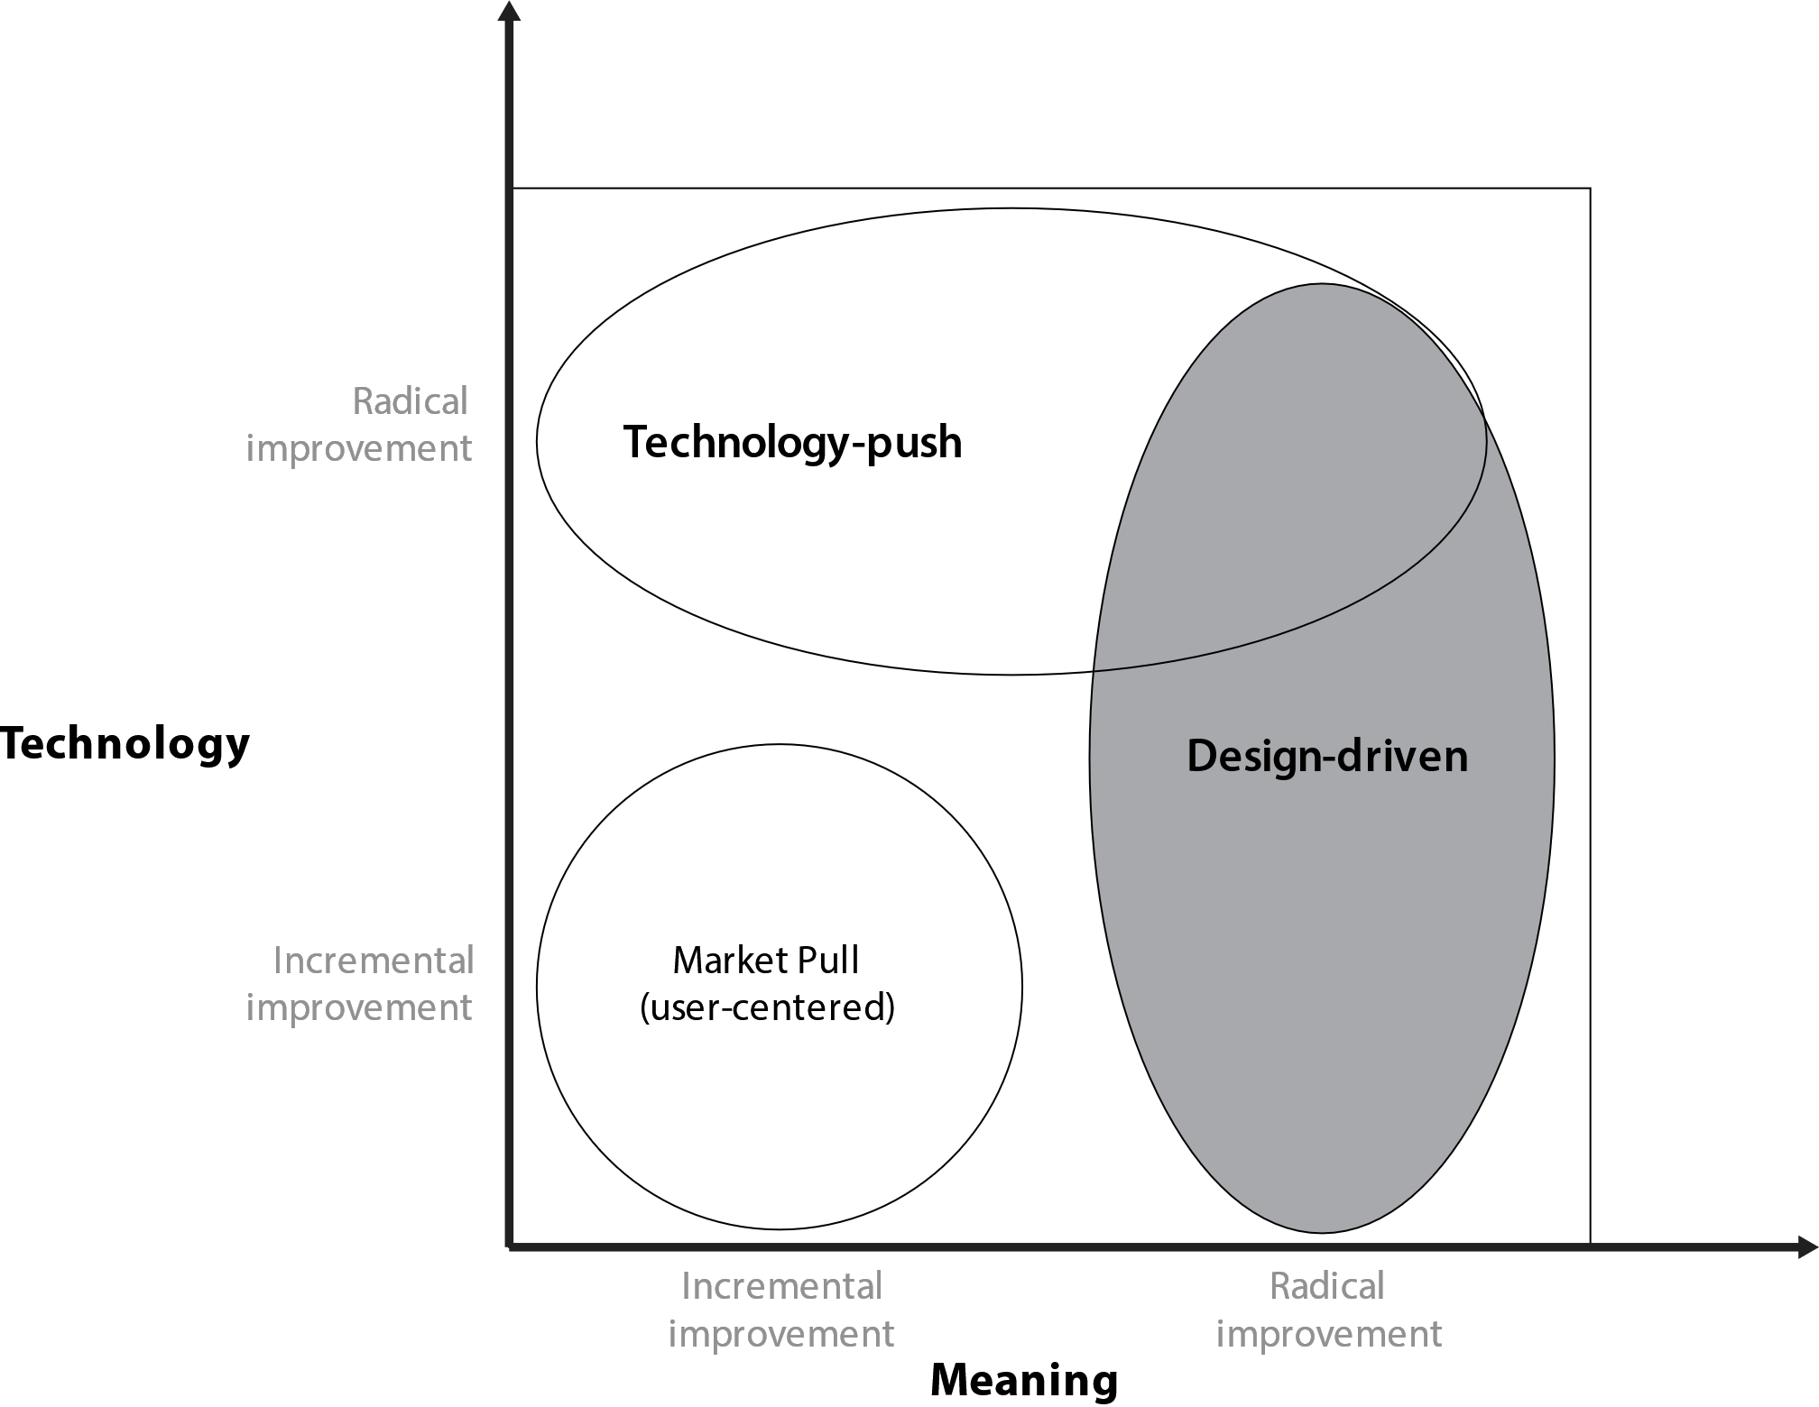

Slide 4
Interpreters
Research and Educational Institution
Field Agriculture – Curator (Wayamba University)
Field Electronics – Prof J.A.K.S Jayasinghe
Technology Suppliers
Adafruit – Water proof temperature sensors.
People
Need manual control

Slide 5
Input from Interpreters
Typically if the temp goes above 45⁰C, there is a high probability that plants will be burnt
Normally the humidity is around 100% - hence when setting a threshold for humidity set it closer to 90%
The farmer should be able to set the temperature thresholds manually
Portable

Slide 6
Input from Interpreters
Design it so that it can be extended for green houses as well
Sensors should be water proof or installed in way that they can be removed when watering
Need the temp and humidity information (sampled hourly) to be stored for 2 weeks.
The temp or humidity in a propagator will not differ largely along it’s area - one sensor for a 22 feet is sufficient.

Slide 7
Changes needed
Meaning – constantly monitored environments
Automated temperature measurement and alerts
Automatic data recording.
Audio-Visual alarms for easy identification
Portable and modular to be used in different propagators
Easy set-up

Slide 8
Our Product
Three units
Sensor
Display
Audio-Visual Alarm
Data recording
Accuracy
Wireless and Battery powered
Water proof.

Slide 9
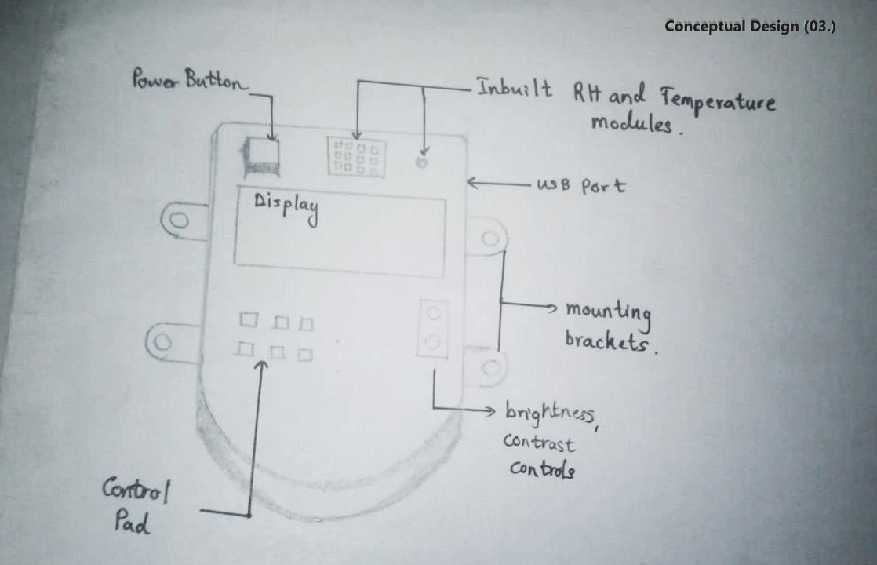
Conceptual Designs

Slide 10
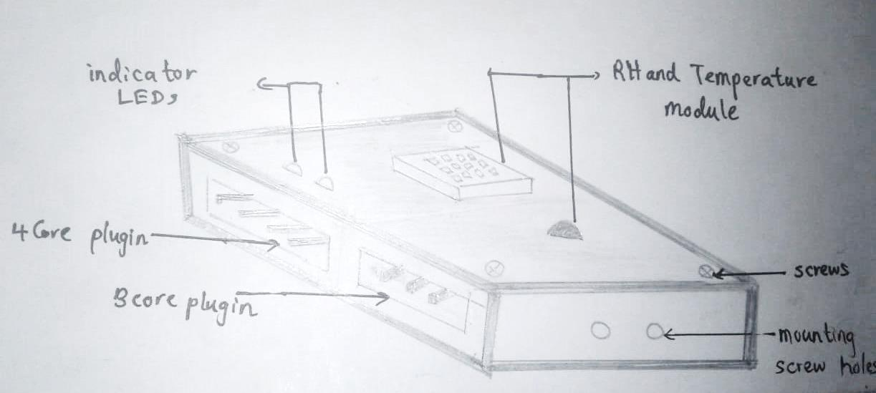
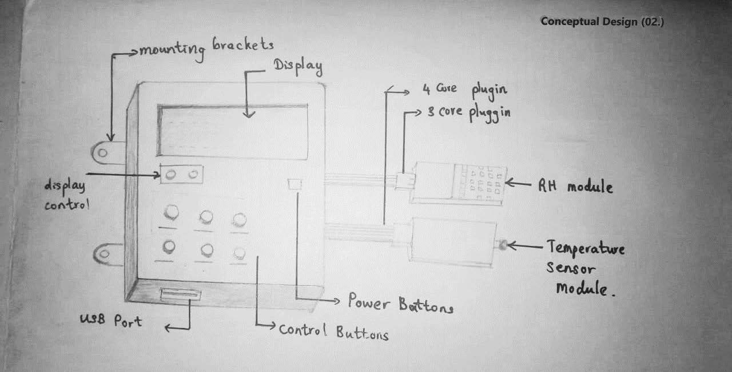
Conceptual Designs

Slide 11
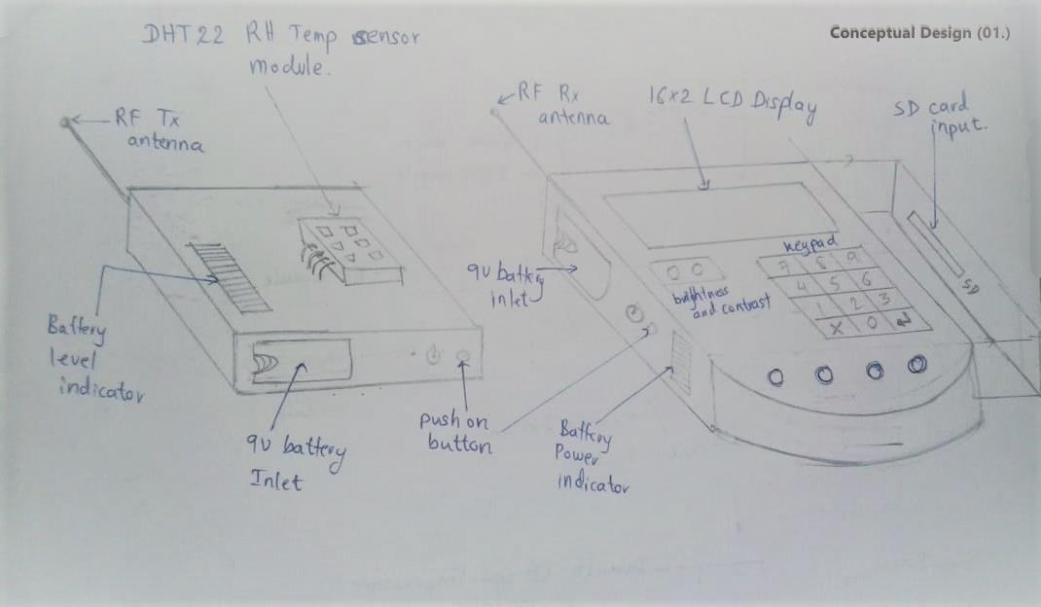
Conceptual Design

Slide 12
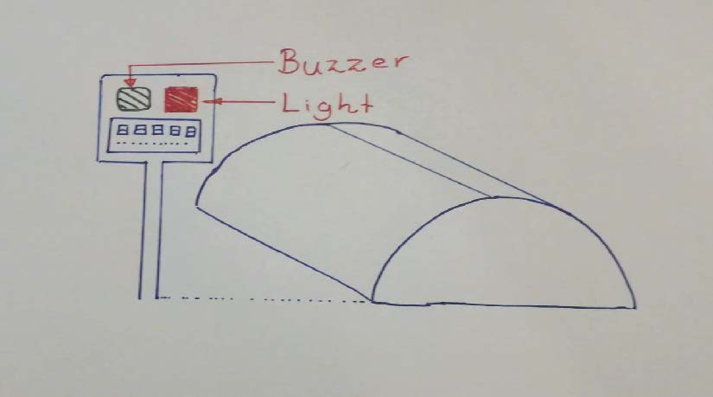
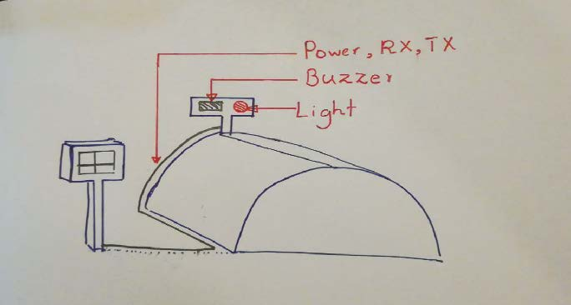

Slide 13
